Slide 1



Department of Computer Science and Engineering
AN APPROACH FOR ENHANCEMENT OF RETAIL SHOPS AND RENTAL SYSTEM
Team Members Name / Register Number
DANIEL GEORGE.S - 211420104051
ELAVARASAR.P – 211420104072
ESHWANTH.A.G-211420104079
Project Guide:
Dr.Sathish Kumar.P.J,M.E,Ph.D.,
Professor

Slide 2
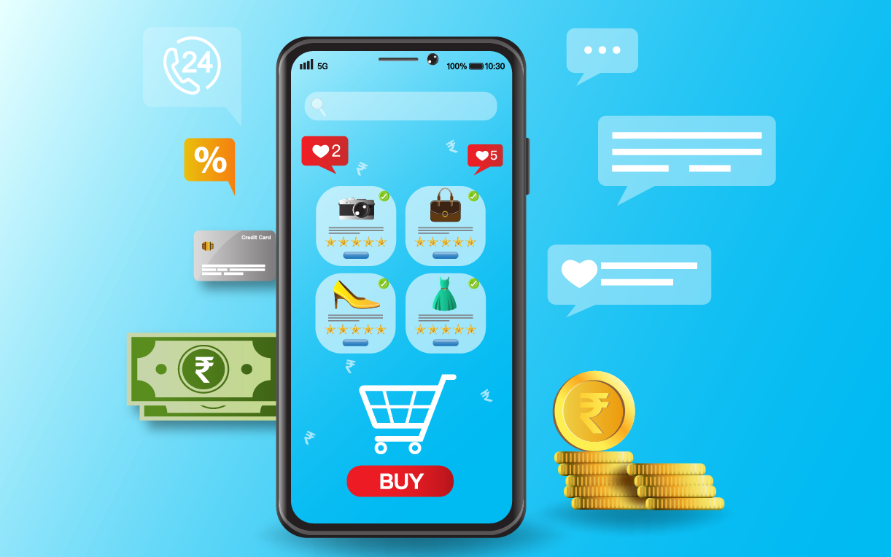
PROBLEM DEFINITION
M-commerce is a rapidly growing trend that offers many benefits for both vendors and customers.
In M-commerce Third Party Agent is making more Profit than the customer and vendor.
How to overcome such Situation and how we can improve Rental System in M-commerce?
How to give various local service to Homely People

Slide 3
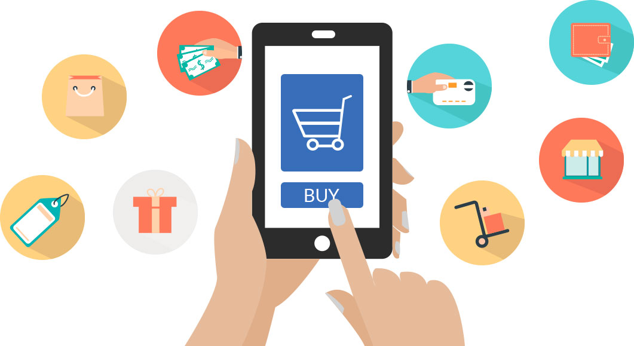
ABSTRACT
As technology advances, M-commerce will become even more integrated into our lives.
The main purpose is to take measure to reduce the interaction of agent between Buyer and Seller which makes profit to the third party agent.
The existing system results in downturn in economy of retail shops as well as middle level family.
The proposed System will make more interaction between Buyer and Seller by making chat box to communicate Seller for more details.
This also makes Profit to Retail shops and make enhancement in Rental system in E-commerce.

Slide 4
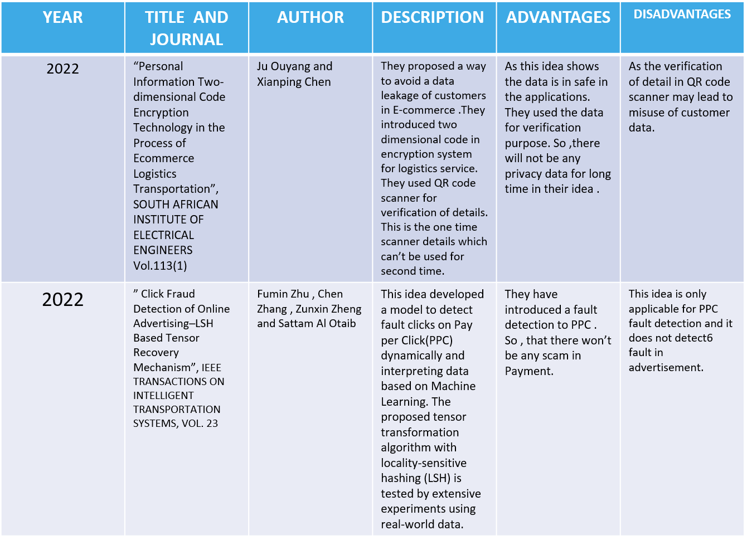
LITERATURE SURVEY

Slide 5
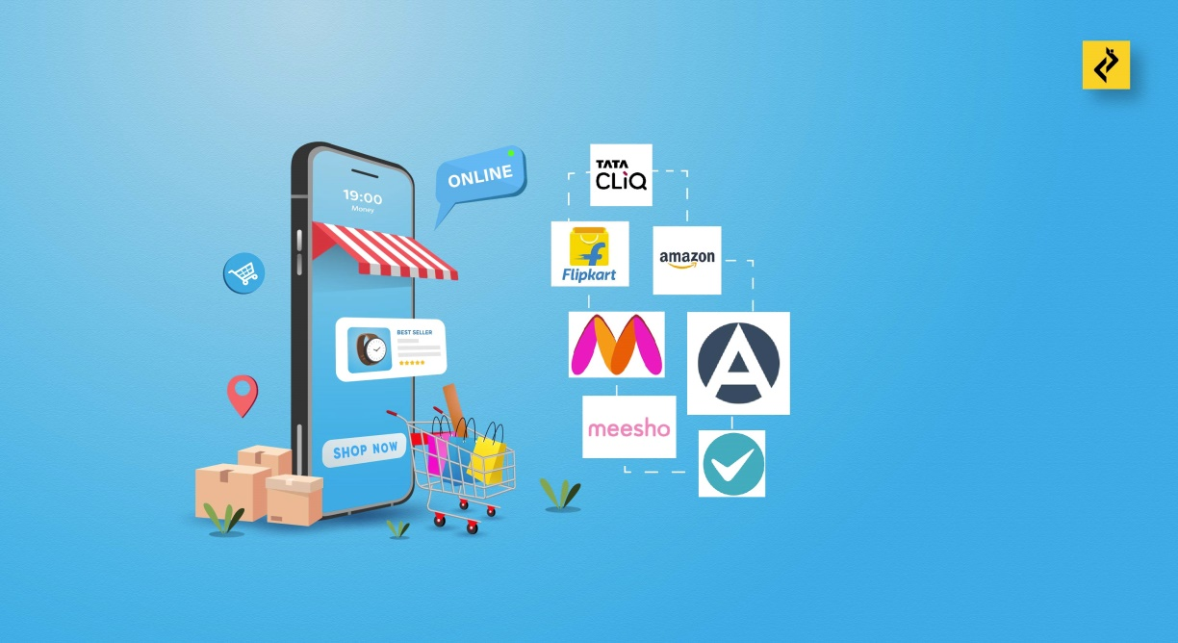

EXISTING SYSTEM
Only Buying and Selling the product
Less interaction between seller and buyer
Third party agent making profitable
Lack of Rental based system
Downturn in Local Bodies
We need to search Manually for Services Nearby

Slide 6

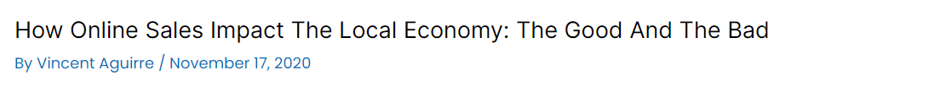
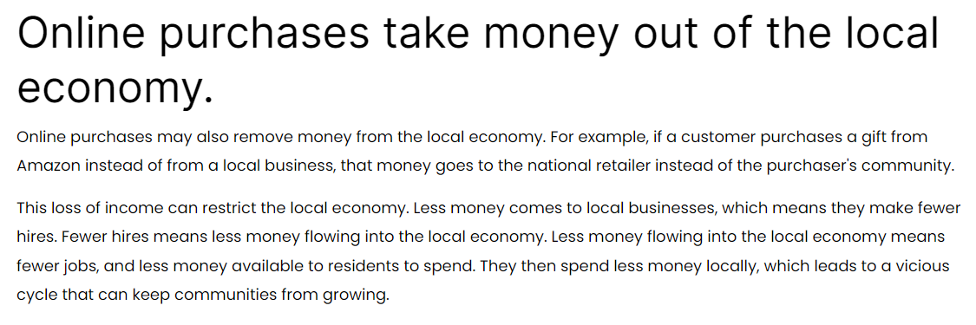

Slide 7
PROPOSED METHODOLOGY
Renting , Selling and Buying the product.
Enhancement of Retail shops.
Chat box for Customer and Seller.
Searching the products in nearby shops and can able to find the price difference for those products.
Searching for Services in a nearby place

Slide 8
MODULES
Authentication and Validation module.
Category module
Renting module.
Cart and payment module.

Slide 9
Software / Hardware used
Flutter Framework
Google Firebase
A mobile device with version 11 or above

Slide 10

ARCHITECTURE:
Firebase
Rent
Seller
Upload products
Sale
Send Product
Update product
Basic information
Private chat
USER
Receive
Product
Feedback
Or
review
View Products
Buyer

Slide 11
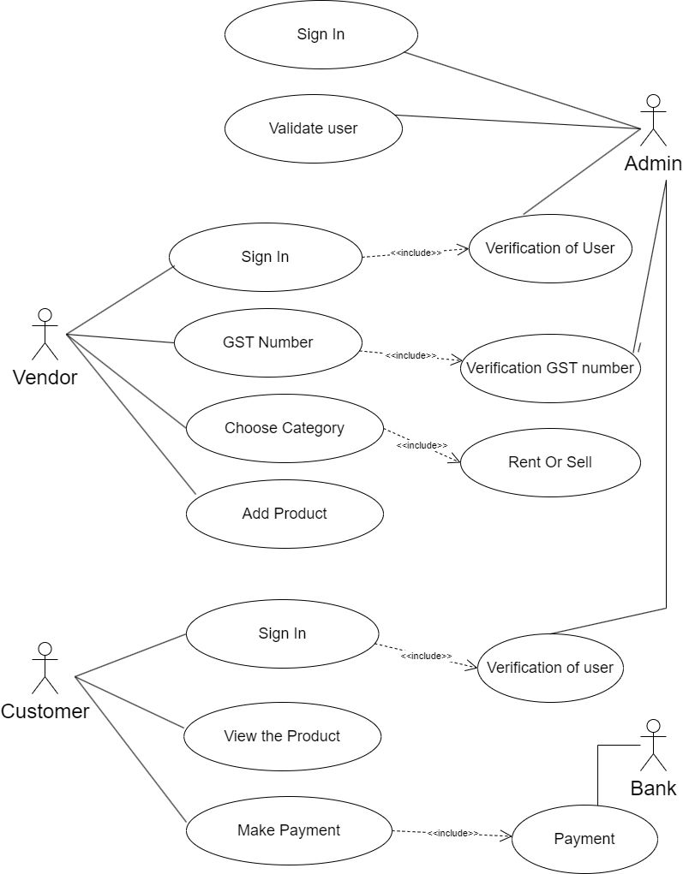
UML DIAGRAM
USECASE DIAGRAM

Slide 12
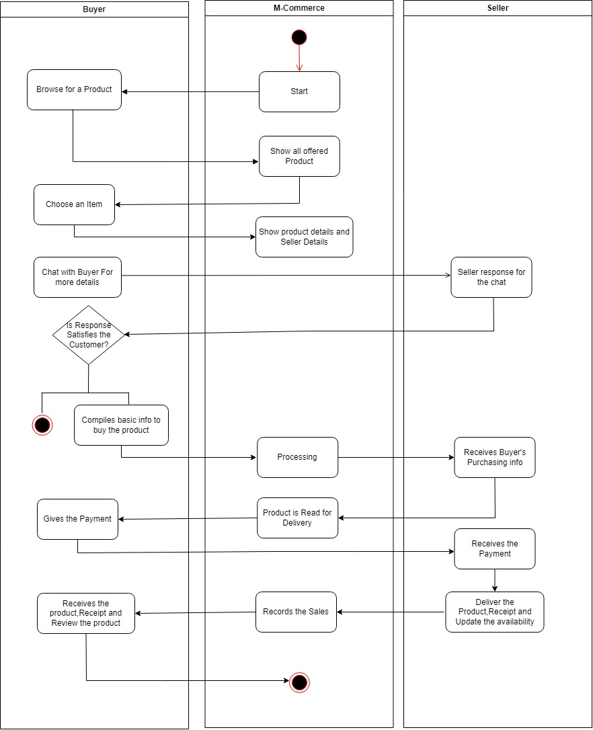
ACTIVITY DIAGRAM:

Slide 13

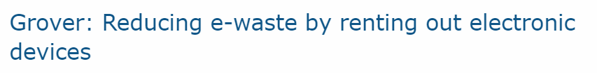
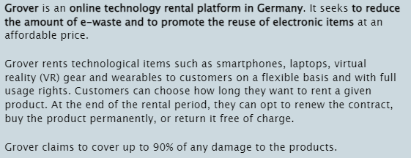
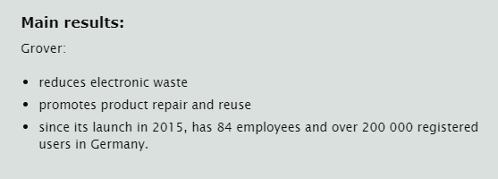

Slide 14
MODULE DESCRIPTION
User
The user can be a Seller or Buyer .When the Buyer login the app, he needs to give the Basic information and can view the products. Meanwhile, the Seller needs to give his information to upload the products.
2. Information
For the Buyer the information details is simple ,just his name and stuff like that. But for the Seller the details are like GST number, his address , phone number and more and more specific details such as the product details.
3.Upload Products
After the Seller give his personnel details and the details of the product to be uploaded, the product is uploaded to the app and it can be viewed by the buyer. The upload section consists of two part Rent and Sale and the Seller has to select the particular section to upload his product.
4.View Products
The buyer can view the products which he was searching for his need in the app. If the product satisfies his needs he can proceed for order.

Slide 15
5.Private Chat
The Buyer can chat with the seller to know more about the product details. The Seller can send more details to the buyer by sending more images of the products ,etc. It makes the Buyer to feel trustworthy to buy the products.
6.Send Product
After the order is confirmed by the Buyer , the seller sends the product order buy the Buyer.
7.Receive Product
The product sent from the Seller is received by the Buyer.
8.Product Update
After the product has been sent , the seller has to update the availability of the products.
9.Feedback
After the product received by the Buyer, he has to give the feedback about the experience and the product usage.

Slide 16
TESTING/PERFORMANCE EVALUATION/RESULTS
TEST CASE ID | TESTCASE/ ACTION TO BE PERFORMED | EXPECTED RESULT | ACTUAL RESULT | PASS/ FAIL
1. | Selecting “BECOME A VENDOR” button | Display sign up page | Displays sign up page | Pass
2. | Selecting “SIGN IN” button | Display sign in page | Display sign in page | Pass
3. | Select “MOBILES” button | Enter into MOBILES products page | Enters into MOBILES products category page | Pass
4. | Select “ELECTRONICS” button | Enter into electronics products page | Enters into electronics products category page | Pass
5. | Selecting “JEWELS” button | Display jewels product page | Displays jewels product category page | Pass
6. | Selecting “SHIRT” button | Display clothes product page | Displays clothes product category page | Pass

Slide 17


APP LOGO AND ICON

Slide 18
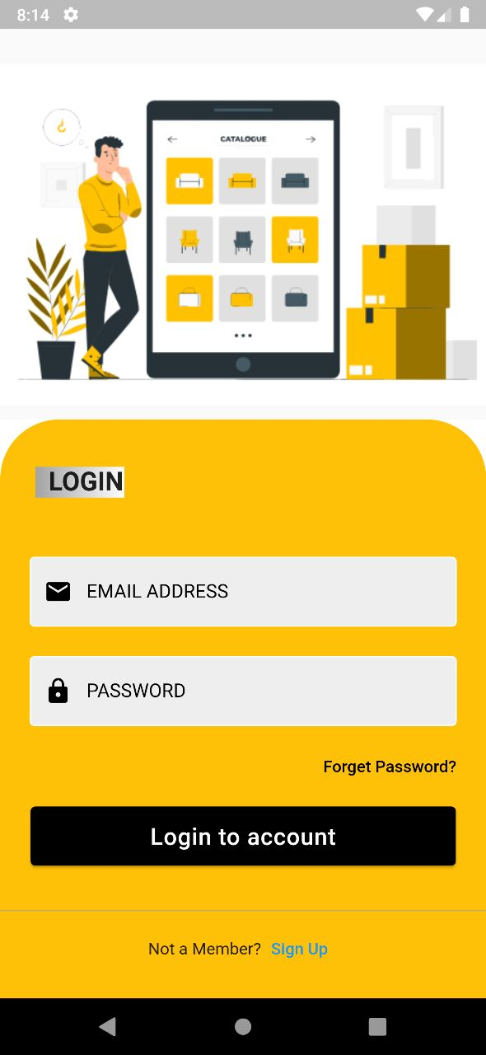
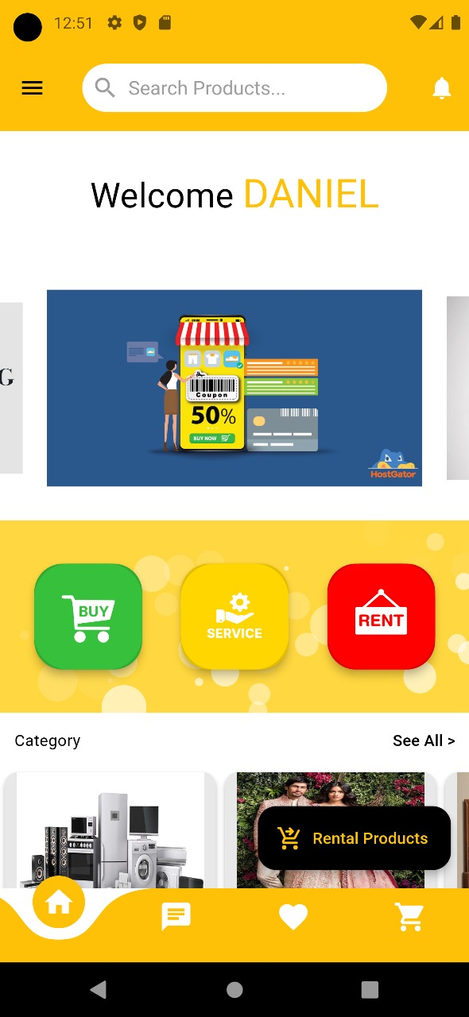
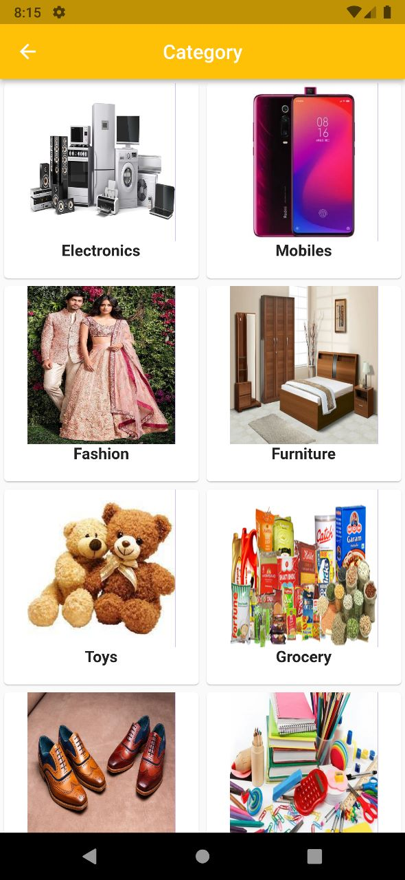
DEMO PAGE
Login Page
Home page
Category Page

Slide 19






FEATURES:
Direct Chatting between buyer and seller
Renting the Products
Various Service in a nearby Place
A step forward to reduce Electronic-waste

Slide 20
Reference Paper/ URL
1.Kai Fan*,Hui Li, Wei Jiang, Chengsheng Xiao, and Yintang Yang," Secure Authentication Protocol for Mobile Payment ",TSINGHUA SCIENCE AND TECHNOLOGY ISSNll1007-0214 09/10 pp610–620,Volume 23, Number 5, October 2018.
2.Ju Ouyang, and Xianping Chen ,"Personal Information Two-dimensional Code Encryption Technology in the Process of E-commerce Logistics Transportation ",SOUTH
AFRICAN INSTITUTE OF ELECTRICAL ENGINEERS Vol.113 (1) March 2022.
3.Junyi He , Di Zhang , Ju Ren,Yuezhi Zhou,and Yaoxue Zhang,"Online Market Mechanism for Mobile Data Rate Trading With Temporal Constraints",IEEE INTERNET OF THINGS JOURNAL, VOL. 9, NO. 20, 15 OCTOBER 2022
4.Falah Y H Ahmed,Eizwan Bin Hazlan and Muhammad Irsyad Abdulla,” Enhancement of Mobile-Based Application for Vehicle Rental”, 2021 IEEE 11th IEEE Symposium on Computer Applications & Industrial Electronics (ISCAIE), Penang, Malaysia, 03-04 April 2021.
5. Eric Hsueh-Chan Lu and Zhan-Qing Lin,” Rental Prediction in Bicycle-Sharing System Using Recurrent Neural Network”,IEEE ACCESS, Received April 12, 2020, accepted May 2, 2020, date of publication May 14, 2020, date of current version May 29, 2020.

Slide 21

CONCLUSION
In 2022, an increase of 3.4% was estimated of the generated e-waste globally, hitting 59.4Mt , which made the total unrecyclabled e-waste on earth to 2022 is over 347 Mt.
Most of the e-waste is generated due to unused product.
We can able to convert most of the good condition unused product to useful product which makes reduce of 15-30% e-waste.
This makes intermediate free , so that both Buyer and seller can able to get profitable. Thus it makes the economy upturn in local retail shops .

